Slide 1
Respiratory Case

Slide 2

Telemedicine / Telehealth
What does this mean? When can it be used?
Notes:
(3 minutes) BREAKOUT ROOMS: Advantages v. Disadvantages of Telehealth

Slide 3
Our First Day on the Tele-Health Job
Notes:
Jessica should pop in by at least 18 mins

Slide 4
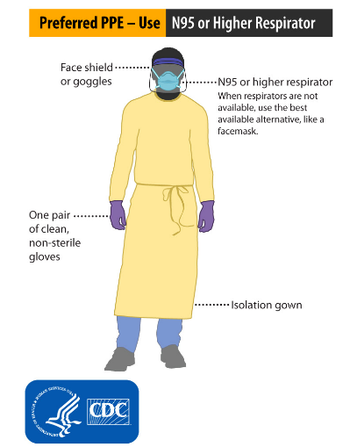
Source: CDC

Slide 5
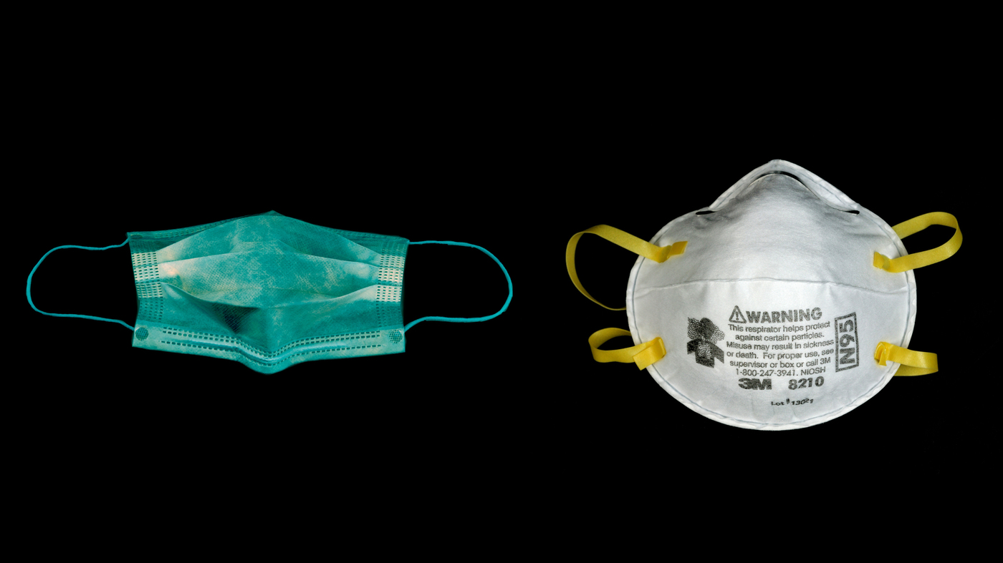

Surgical Mask
N95
Cloth Masks
Source: NPR, Gannett

Slide 6
Initial Vitals
 | Heart Rate (beats per minute) | Blood Pressure | Temperature | Oxygen saturation | Respiratory Rate (breaths per minute)
Patient | 95 | 120/70 | 102F | 85% | 25
Normal | 60-100 | ~120/80 | 98.6F | 95-100% | 12-20
Notes:
(5 min) Breakout groups, with each group getting 1,2, or 3 to discuss: 1) Interventions to improve vitals 2) Questions to ask the patient 3) Tests to understand more about patient -- come together to discuss briefly

Slide 7
Vitals, After Oxygen
 | Heart Rate (beats per minute) | Blood Pressure | Temperature | Oxygen saturation | Respiratory Rate (breaths per minute)
Patient | 95 | 120/70 | 102F | 90% | 21
Normal | 60-100 | ~120/80 | 98.6F | 95-100% | 12-20

Slide 8
Part 1 Labs
 | Value | Reference Range
White blood cell count | 9,000 | 4,000 - 11,000
Influenza A | Negative | Negative
Influence B | Negative | Negative
Sputum culture growth | Positive for growth | No growth
Sputum culture species | Mixed flora (Streptococcus pneumoniae, Haemophilus influenzae, Staphylococcus aureus, and Klebsiella species) | N/A

Slide 9
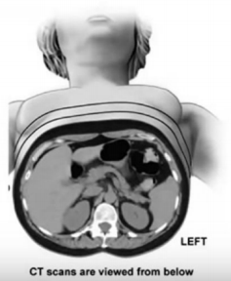
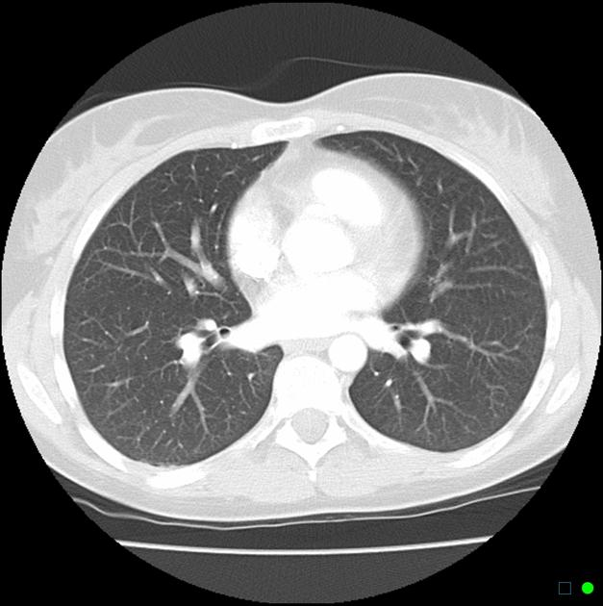
CT Scan
Source: Memorial Sloan Kettering, Radiopaedia

Slide 10
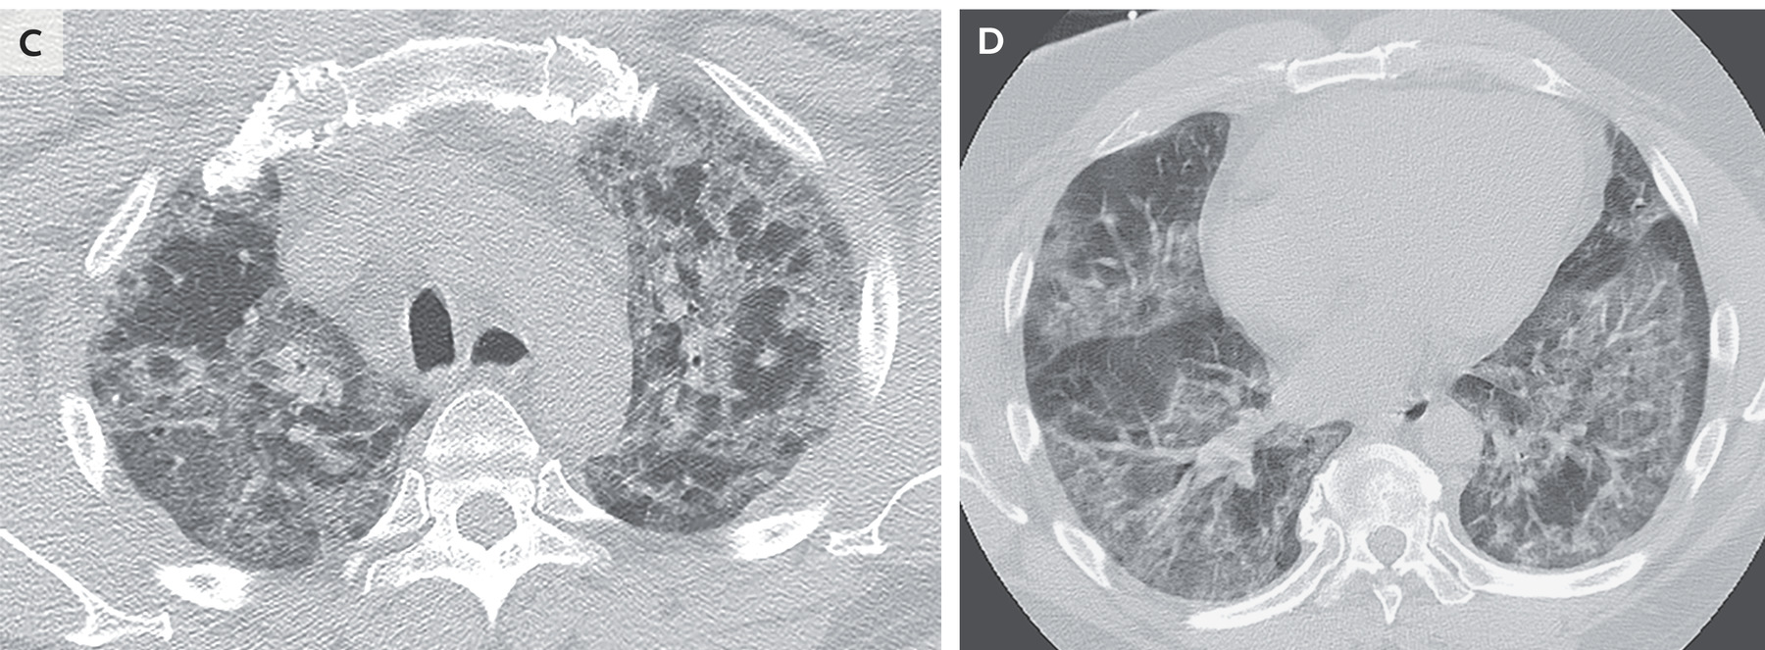
Normal
Your patient
Source: Radiopaedia, NEJM
Notes:
Left = normal CT chest - heart in middle, black spaces = clear lungs, spinal cord at bottom of image, rib cage and sternum are white on border of chest
Right = CT of patient with COVID-19 = lungs filled with “ground glass opacities,” showing that there is fluid in the lungs and evidence of a serious disease process

Slide 11
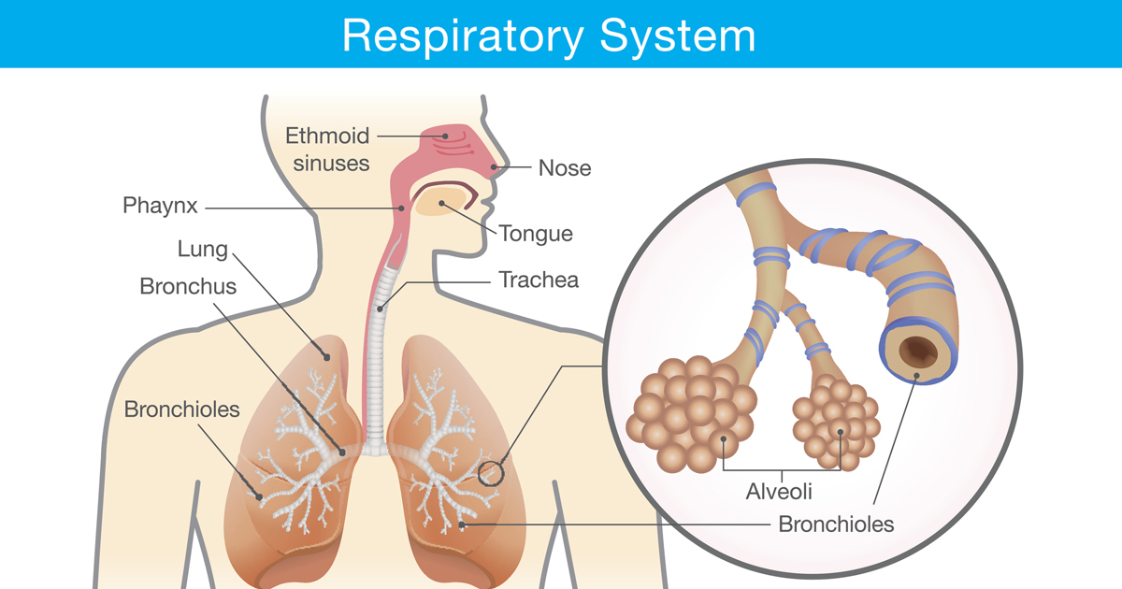
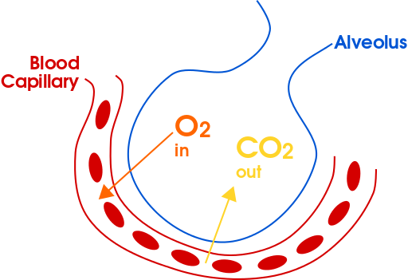
The Normal Respiratory System
Source: El Camino Hospital, Lumen Learning

Slide 12
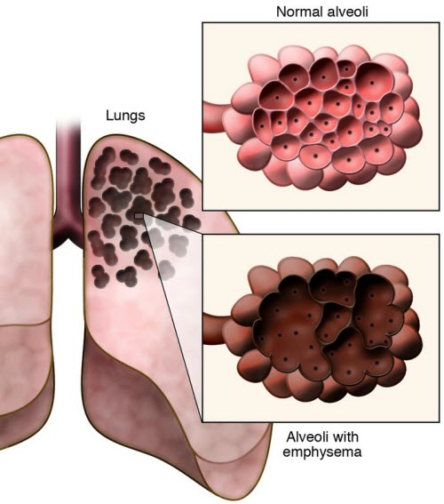
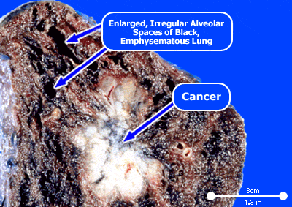
COPD - Emphysema
Source: MedicineNet, Palo Alto VA

Slide 13
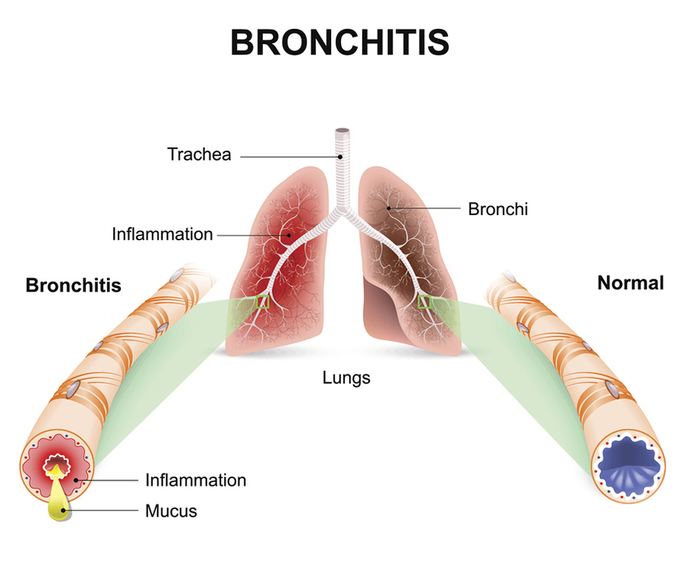
COPD - Chronic Bronchitis
Source: CDC

Slide 14
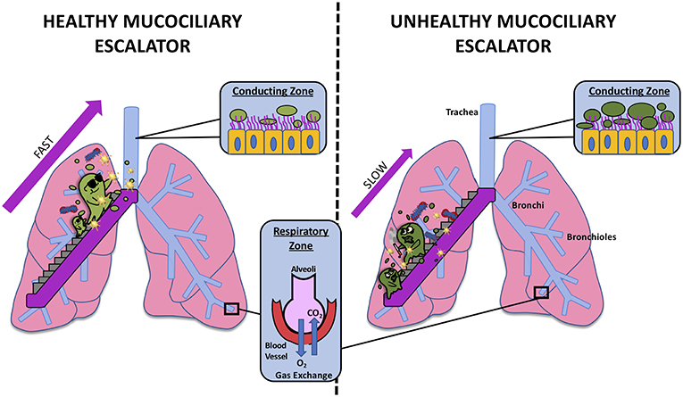
Smoking Destroys the Mucociliary Escalator
Source: Frontiers

Slide 15
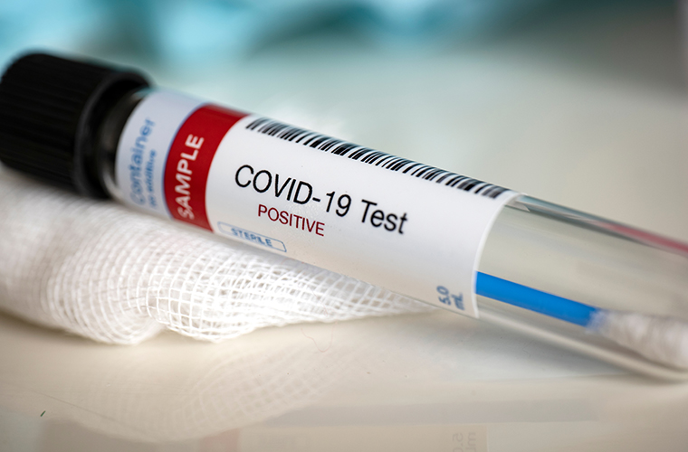
Part 2 Labs
COVID-19 Test: Positive
Source: Baycare

Slide 16
Vitals
 | Heart Rate (beats per minute) | Blood Pressure | Temperature | Oxygen saturation | Respiratory Rate (breaths per minute)
Patient | 110 | 90/50 | 103.2F | 72% | 35
Normal | 60-100 | ~120/80 | 98.6F | 95-100% | 12-20

Slide 17
Vitals
 | Heart Rate (beats per minute) | Blood Pressure | Temperature | Oxygen saturation | Respiratory Rate (breaths per minute)
Patient now | 110 | 105/60 | 103.2F | 73% | 35
Patient, 5 minutes ago | 110 | 90/50 | 103.2F | 72% | 35
Normal | 60-100 | ~120/80 | 98.6F | 95-100% | 12-20

Slide 18
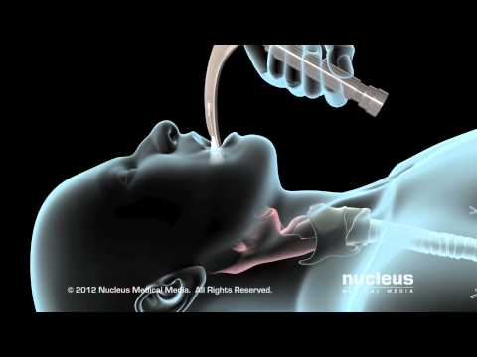
Intubation
Video from Covenant Health

Slide 19
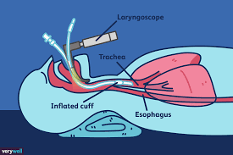
Intubation
Source: VeryWell Health
Notes:
Anatomy of intubation: laryngoscope allows for visualization
Endotracheal tube is positioned in trachea 4-6 cm above carina (where trachea splits into bronchi)
Cuff is inflated to keep tube in place

Slide 20
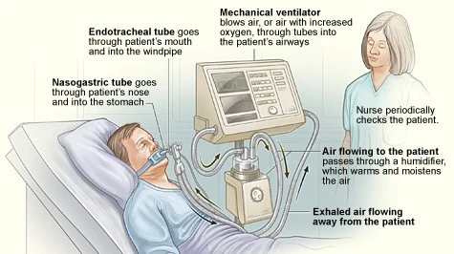
Mechanical Ventilation
Source: Hackaday

Slide 21
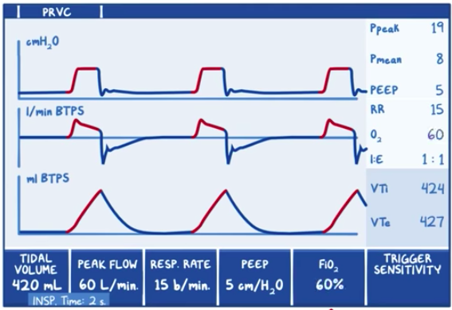
Controlling and Monitoring Ventilation
 | Example Ranges
Tidal volume | 4-6 mL/kg
Respiratory rate | 12 - 20 breaths / min
FiO2 | Up to 1
PEEP | 3 - 5 cm H2O
Source: Osmosis
Notes:
Volume: how big of a breath do you want the patient to take?
Respiratory rate: how fast do you want the patient to breathe?
I:E ratio (Inspiratory: expiratory ratio): How long do you want the inhales to be, compared to the exhales?
FiO2 (Fraction of inspired oxygen): What percentage oxygen is the air flowing through the tube?
PEEP (Positive end expiratory pressure): Do you want to continue to provide pressure flow during the exhale? This is done to keep the alveoli from collapsing.

Slide 22
Vitals
 | Heart Rate (beats per minute) | Blood Pressure | Temperature | Oxygen saturation | Respiratory Rate (breaths per minute)
Patient now | 100 | 105/60 | 103F | 92% | 12
Patient, before intubation | 110 | 90/50 | 103.2F | 72% | 35
Normal | 60-100 | ~120/80 | 98.6F | 95-100% | 12-20

Slide 23
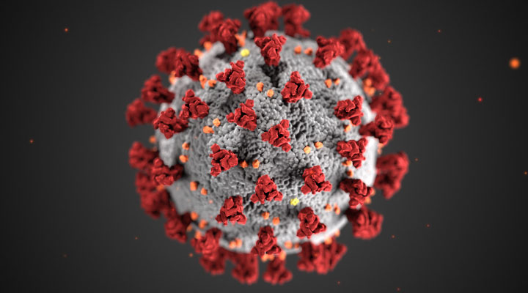
Source: National Institute on Drug Abuse
Notes:
How did COVID emerge as a novel virus? How is COVID-19 spread?
How does COVID-19 replicate in the body?

Slide 24
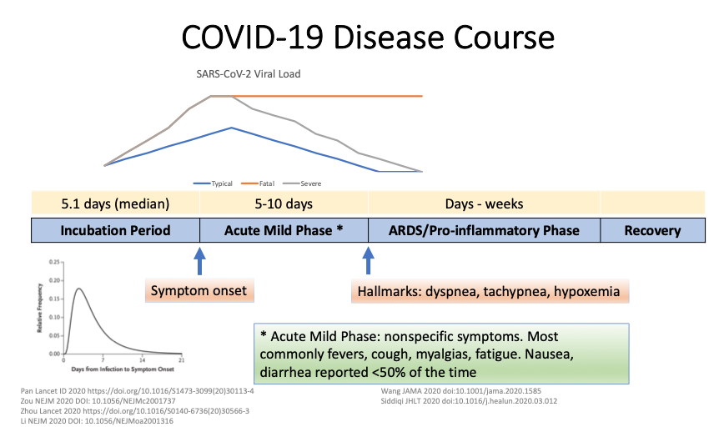
Source: Richterman and Meyerowitz, Partners ID Grand Rounds 3/25/20
Notes:
What are the symptoms of COVID-19?

Slide 25
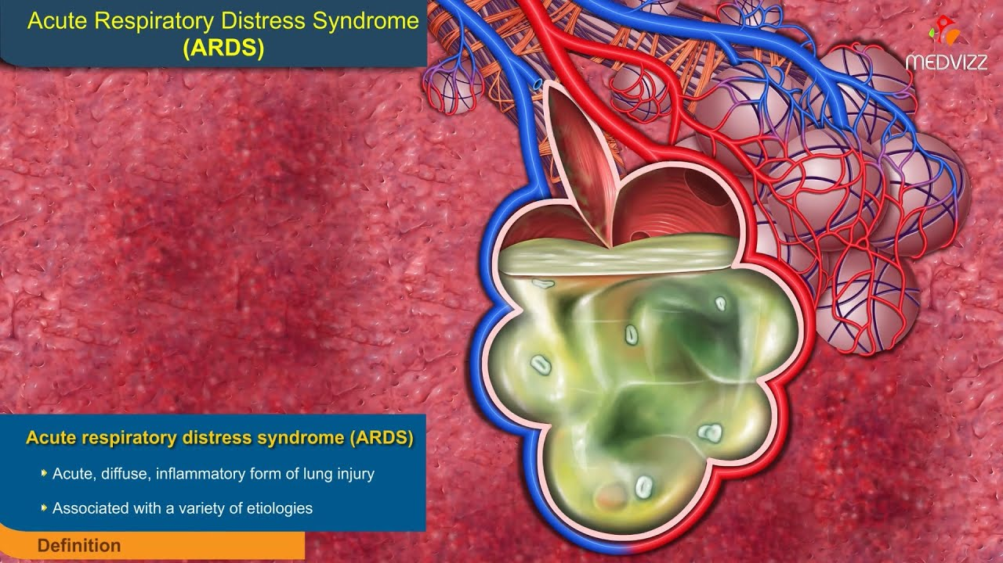
ARDS
Where is the fluid in ARDS?
How does the fluid get there?
What can we do to help?
Source: Medvizz
Notes:
Alveoli
Leaky capillaries -- immune system has capillaries become leaky to allow white blood cells and other components of immune system in bloodstream to get into tissue, but fluid escapes as well
Use pressure on ventilator (PEEP)

Slide 26
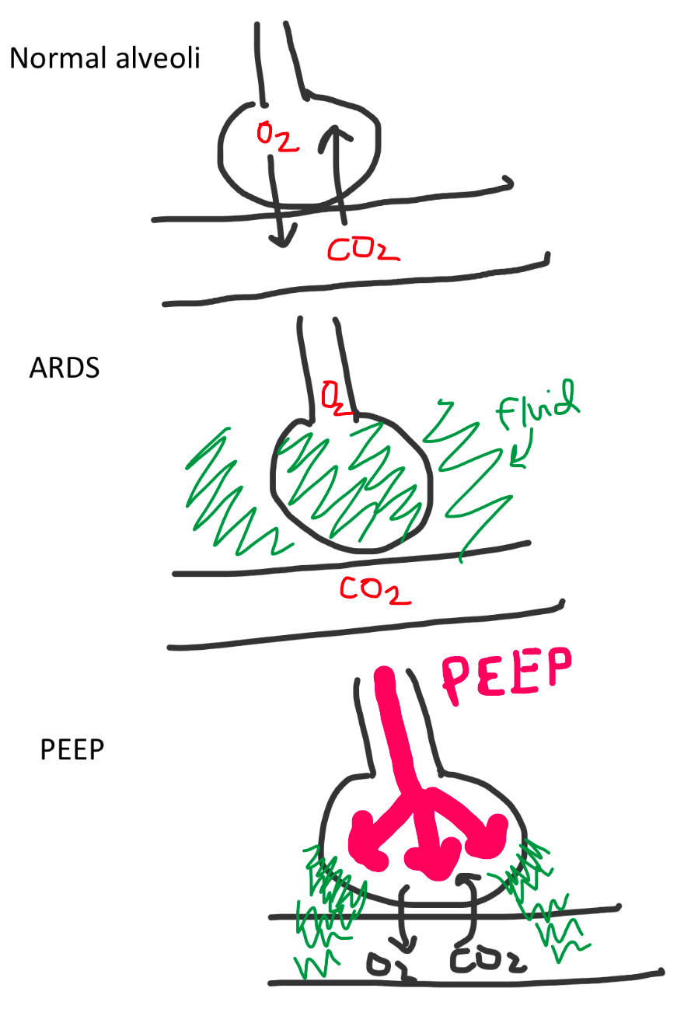
How does a ventilator help a patient with ARDS from COVID-19 recover?
Notes:
How the PEEP setting on ventilators helps patients with ARDS - pressure pushes fluid out of alveoli/interstitum and into the bloodstream

Slide 27
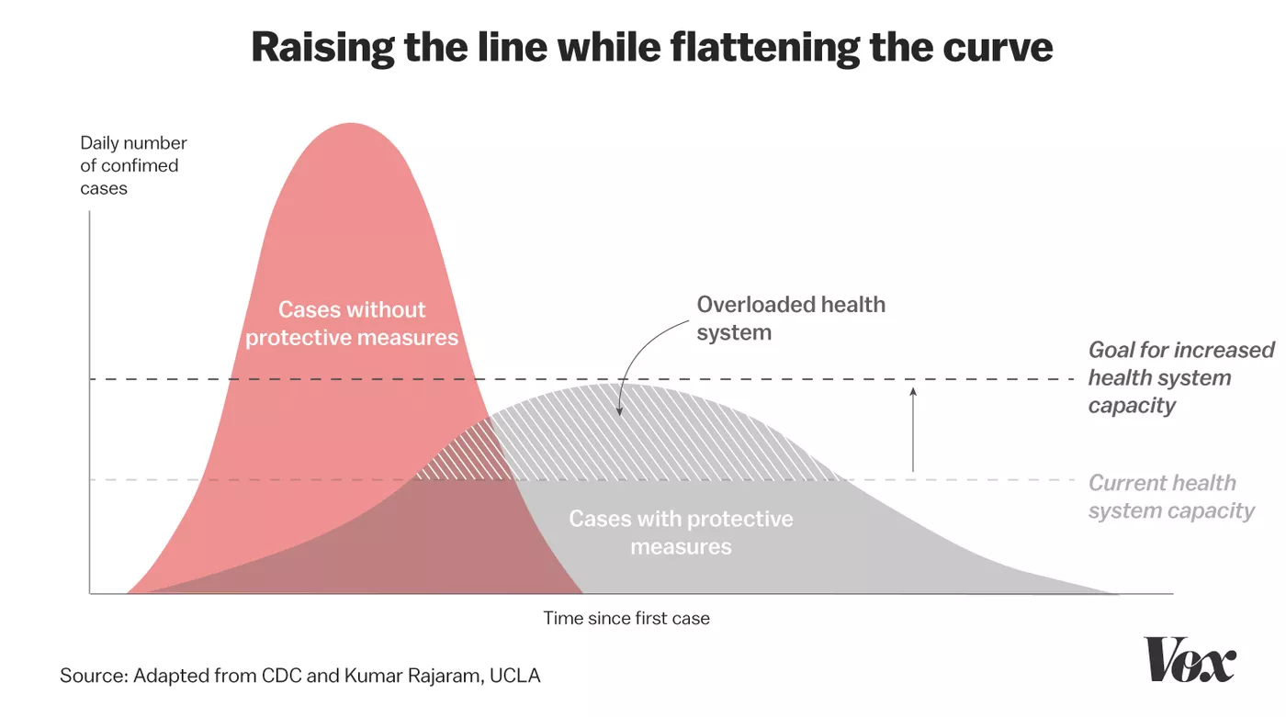
Source: Vox
Notes:
Public Health Principles: Flattening the Curve, Quarantine, and Contact Tracing

